Slide 1
AGM, August 15th 2020
Sickle Cell Foundation of Alberta
Sickle Cell Disease Association of Canada/Association d’anémie falciforme du Canada SCDAC-AAFC
Presented by Biba Tinga
President/Executive Director

Slide 2
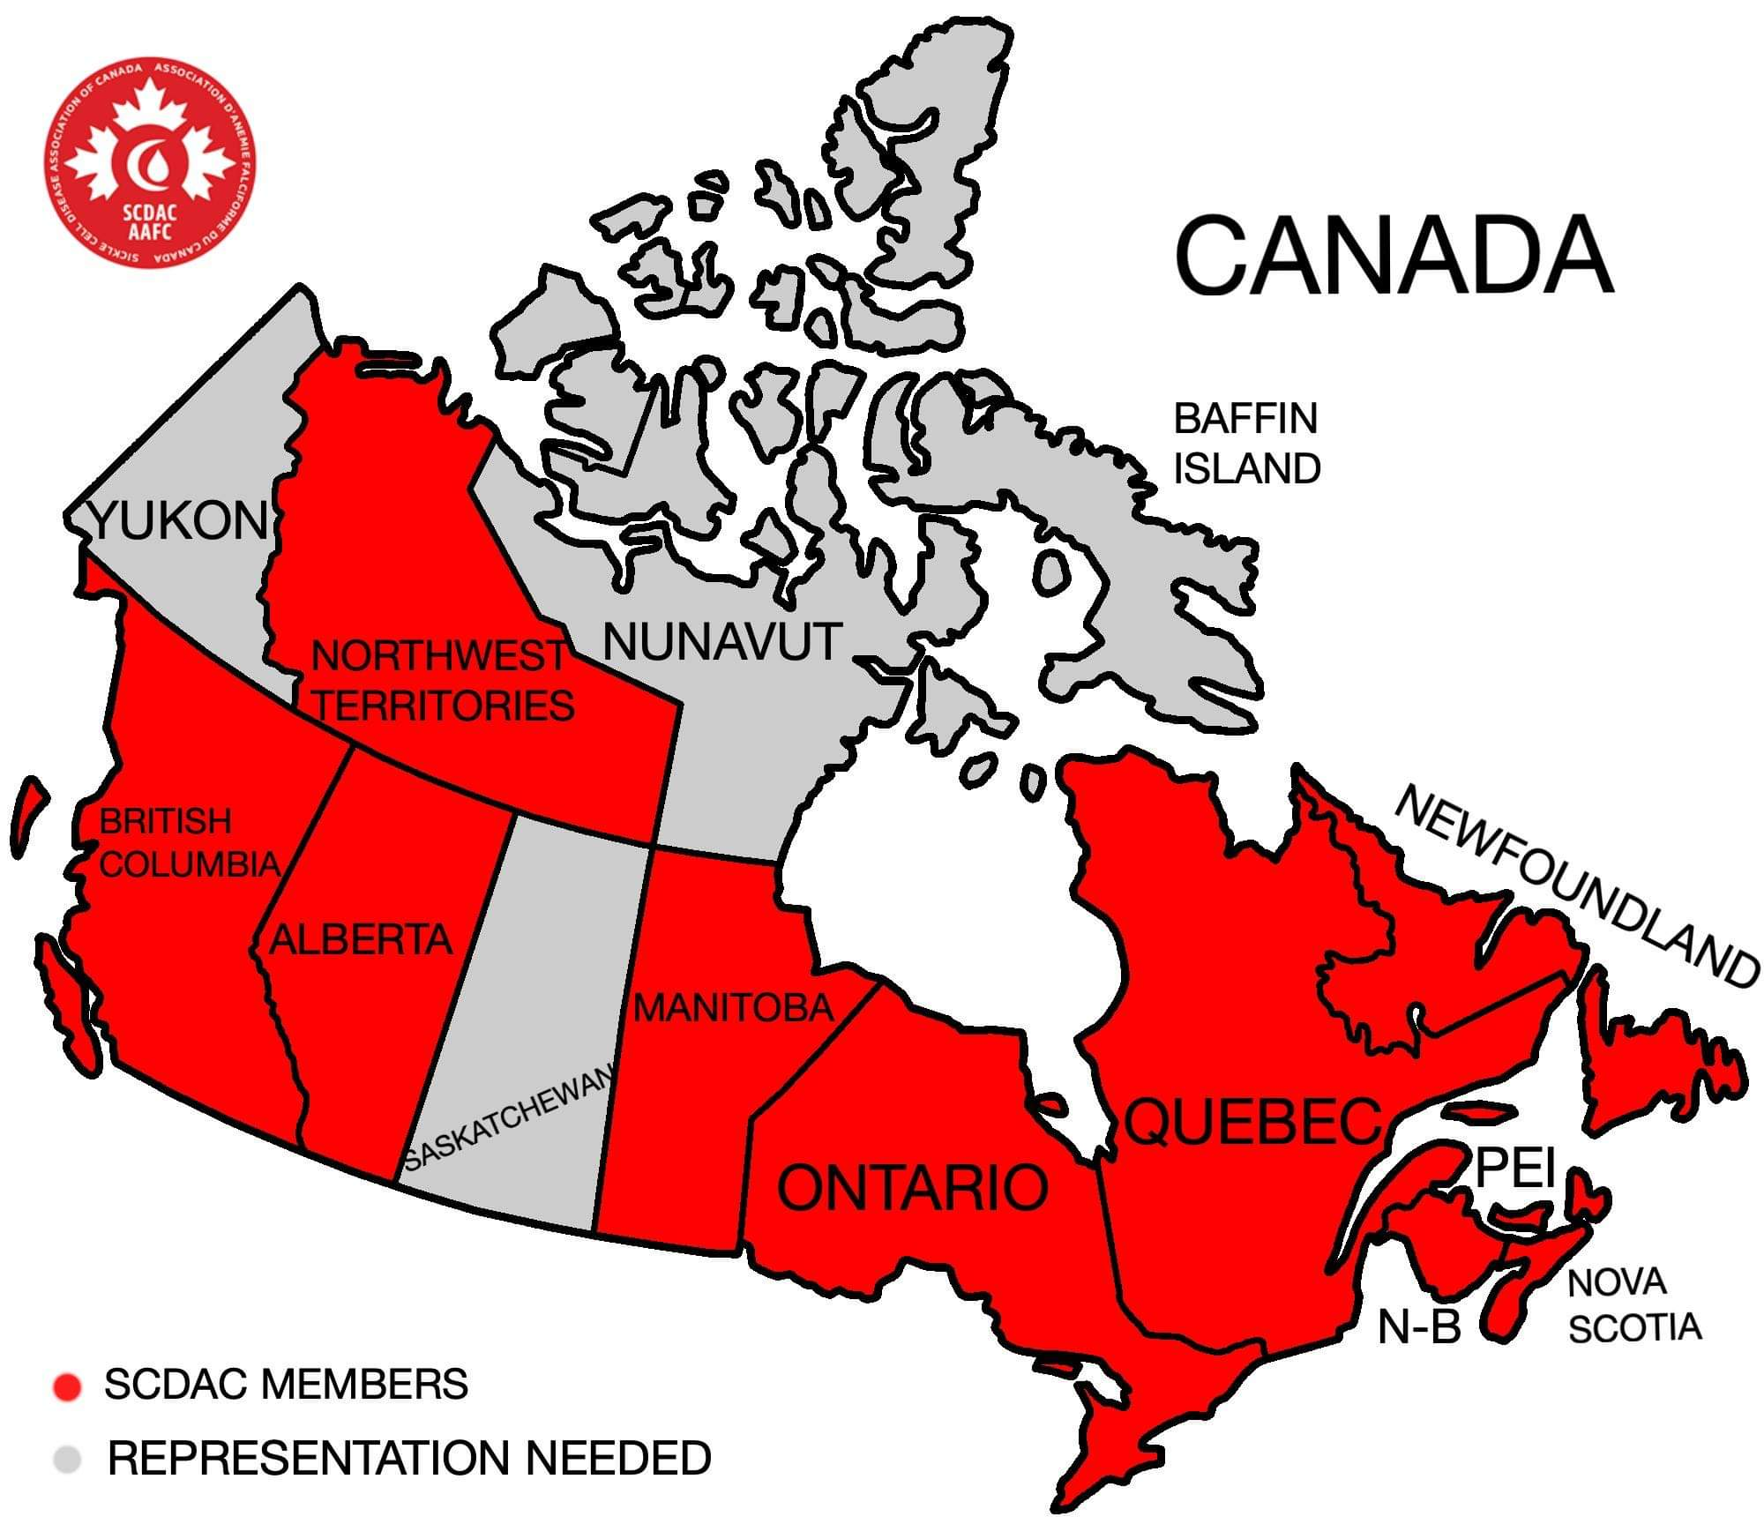
Who are we?
Notes:
Our mission: Created in 2012 as a National Voice for SCD in Canada to better advocate for the 6000 Canadians living with SCD. Newborn screening –Comprehensive care – Access to drugs -

Slide 3
New Innovations in the Treatment of Sickle Cell Anemia
Antibiotics
Pain killers and anti-inflammatory
Vaccines
L-glutamine (Endari)
Hydroxyurea
Blood Transfusion
(High risks: iron overload & hemolytic transfusion reactions)
Bone marrow transplant (only cure available but not for everyone – 10%) – Not largely offered to patients.
Limited Treatment Options: for over 40 years!
It is only supportive care

Slide 4
Hope is materializing!
New drugs have been approved by US FDA:
1 – Novartis: SEG 101 - Crizanlizumab is a monthly infusion to prevent VOCs pain crisis by making Sickle Cell less sticky.
On Nov. 15,2019 -- FDA approved Adakveo
It is considered as a breakthrough therapy because, it has the potential to prevent SCD pain crisis.

Slide 5
SC Patient wants a cure!
2. Global Blood Therapeutics, GBT has developed a drug called voxelotor (GBT440) or Oxbryta. It is an oral, once-daily therapy that keeps Red blood cells from sickling
FDA approved on Nov.25th, 2019
3. Endari, L-glutamine (amino acid) by Emmaus Life Science: oral therapy under review by Health Canada

Slide 6
Gene Therapy: a universal cure?
3- Gene Therapy: availability in 2- 4 years?
Most patients are hoping for a cure thanks to gene therapy.
CRISPR Therapeutics: it allows to edit the gene
First patient in the US – 41 years old - Summer 2019

Slide 7
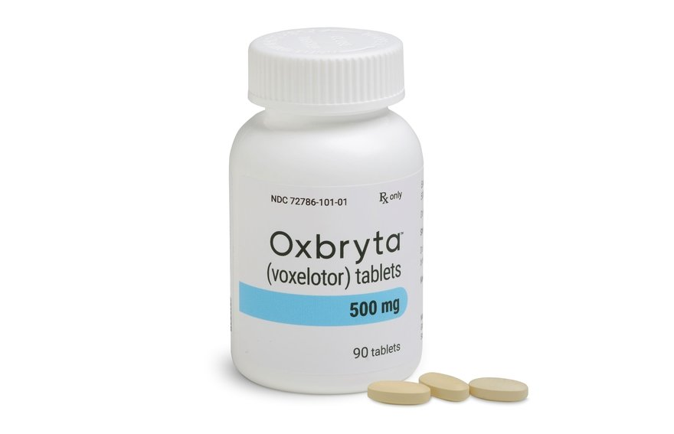
A new Era of HOPE

Slide 8
What are the obstacles?
Gene Therapy: years of monitoring before it is classified as a cure and high cost
Long review process: it can take up to 2 years for Heath Canada to review a new drug safety
Canada Drug pricing: cutting the cost could impact research, development, and future access (refuse to enter the Canadian Market early on)
Small number of patients do not make an attractive market!

Slide 9
What can we do?
As patient group, SCDAC advocates for the best care for the Sickle Cell Community. But we can do it alone!
Mobilize, Organize, Unify and Educate
Our priority: Access to new therapies
Educate patient population to participate in clinical trials
Push for priority review process
Engage key Partners: other rare disease groups ( CORD), Industry Partners
Make sure the government does not forget about us!
Notes:
Our role:

Slide 10
We will be ready!
SCDAC/AAFC is currently working on a National Registry for SCD
Collect data on patients diagnosed with SCD in order to facilitate a wide variety of research
Determine the disease prevalence
Assess quality of life
Improve standards of care
Evaluate novel and existing therapies in real world settings
Notes:
Registry will be a tool for all the key partners in the care of SCD patients

Slide 11
Core Ecosystem Element
Registry
Researchers
Industry
Clinicians
Health Care System
Investigator Network
Patient Organizations
Government
Patients Families Caregivers
Courtesy of Dataffinity
Notes:
A registry serves as a core ecosystem providing not only access to data to a broad group of stakeholders but also has network effects which strengthen connections between stakeholders that can facilitate research and improve care.

Slide 12
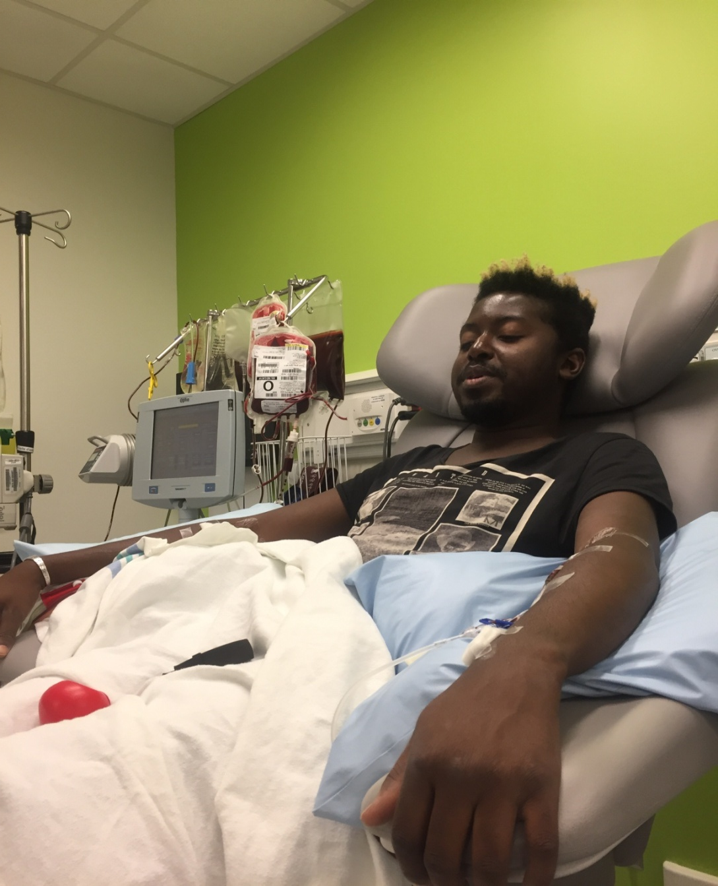
A sickle Cell patient getting blood exchange

Slide 13

SCDAC has a PFL Number with Canadian Blood Services

Slide 14
Advancement through collaboration
SCDAC will collaborate with SCFA to make the Pint Size App project a nationwide one.
We need second generation blood donors!
In the covid-19 pandemic, blood drived are impossible. The App will be the most effective tool to reach the community members, especially our youth.
Looking forward to launching this project!

Slide 15

Merci!
Thank you

