Slide 1
Visible Minorities: Blood, you have it to give.
Presented
By
Dr. Jean Walrond Ph. D.
Dillon Jayachandran,
Arnold Gihozo,
Papa-Ollennu Adjaye,
&
Felix Ikokwu

Slide 2
Dillon Jayachandran
Research Supporting Officer
djayacha@ualberta.ca

Slide 3
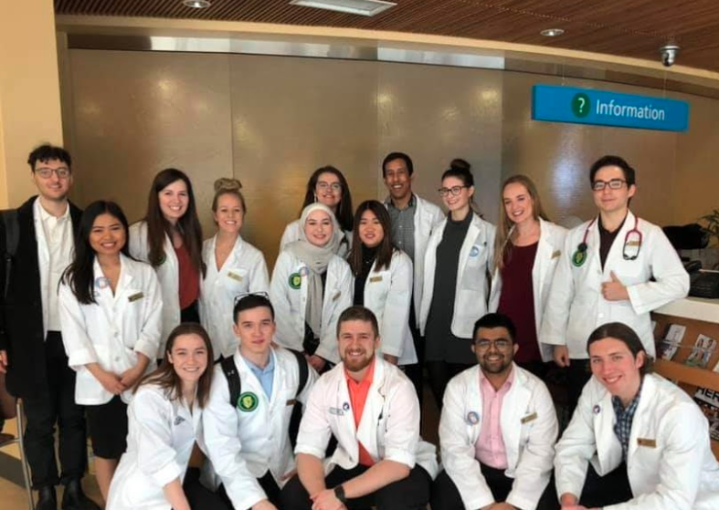
About Me
BSc. from U of A (2016)
Biological Sciences Major, Psychology Minor
Current Doctor of Pharmacy student (entering 3rd year)

Slide 4
My Role
Quantitative analysis of gathered data
Use of SPSS to convert questionnaire data into numerical data for further analysis
Creation of a code book (defining questions as variables, answers as numbers), applying the codebook to SPSS, inputting questionnaire data and interpreting
Using data to assess factors related to blood donations

Slide 5
Arnold Gihozo
Software Developer

Slide 6
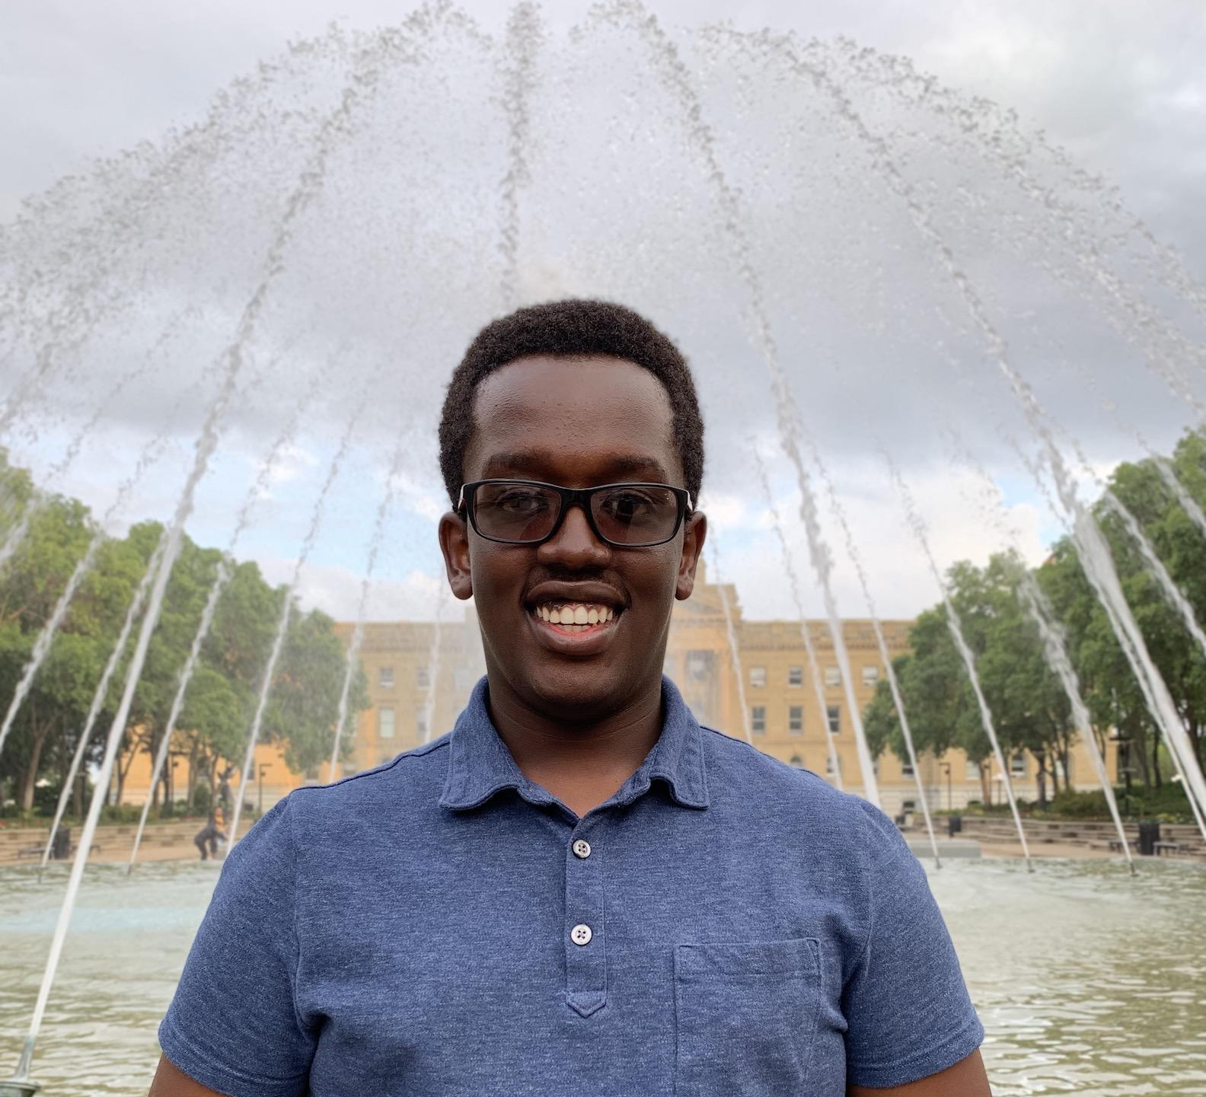
About Me:
Bachelor of Science in Computing Science at the University of Alberta
President of the Augustana Students Association
Current Position:
Software Developer with Sickle Cell Foundation of Alberta

Slide 7
My Role:
Work on the Architecture of the project
Design the front-end and back-end of the application
Design an iOS and Android Application

Slide 8
Work Completed
Dveloping the Front- End
Developing the Back-End
Database
Logic of the application (information processing, data retrieval and loading)
Data Storage
Test cases
Security
Sreens
Transition
Design

Slide 9
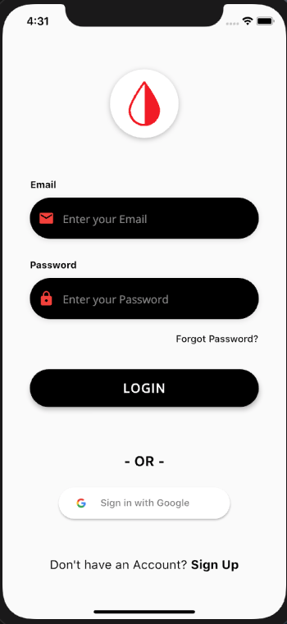
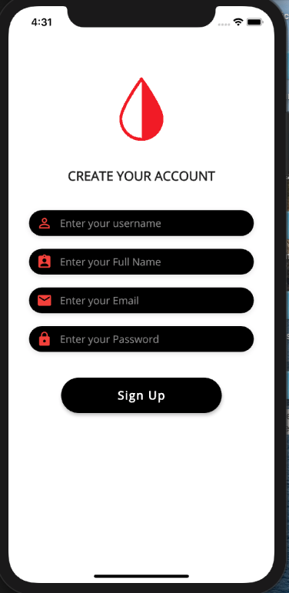
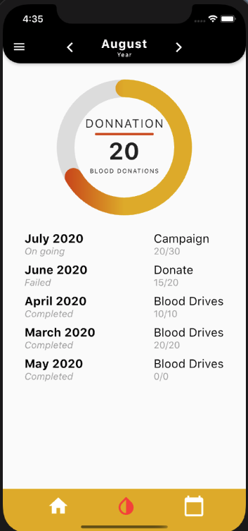
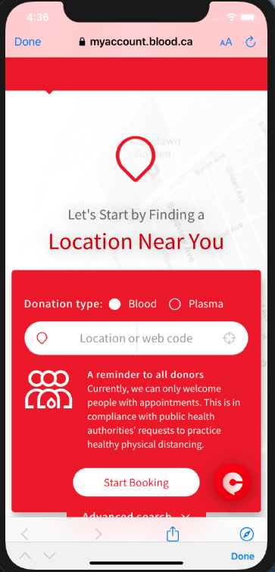
Screenshot
Pint Size App

Slide 10
Quick Look at the App

Slide 11
Next Steps
Continue working on the Security
Improve User Interface
Connect App to CBS database
Continue bug hunt and fixing

Slide 12
Papa-Ollennu Adjaye
Social Media Campaign

Slide 13
About Me:
3rd year Chemical Engineering Student at the University of Alberta
Former basketball player and now basketball Coach
Community work in the twins and triplet festival and at church

Slide 14
My Role:
Post a minimum of three times per day on social media sites
Design templates for campaign
Develop hashtags
Design uniformed cover for all social media platforms
Track followers and follow key organizations and people

Slide 15
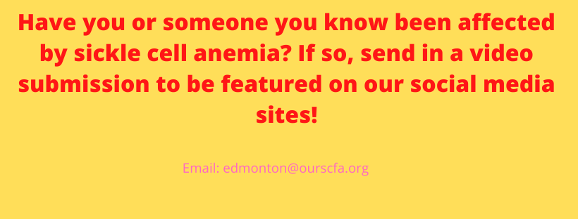
Development of content:
Call for video submissions
Link’s to articles
Promotion of our apps and data

Slide 16
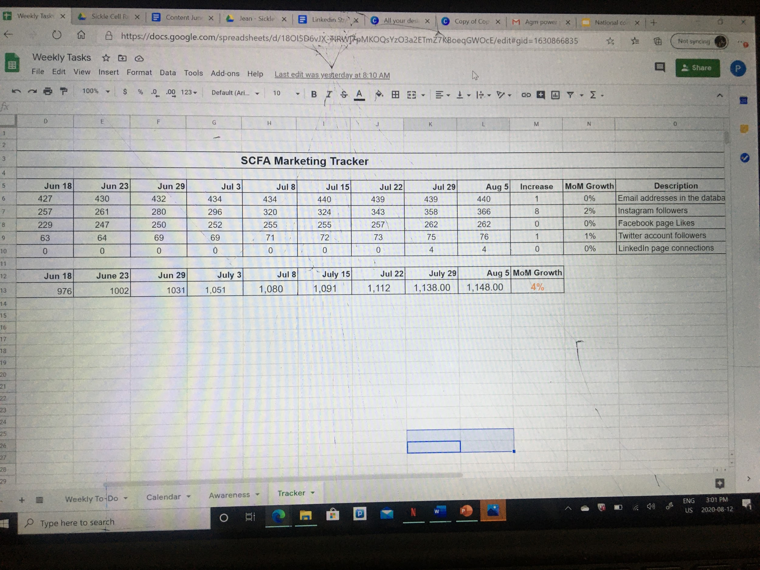

Slide 17
h
h

Slide 18
Felix Ikokwu
felixikokwu@Hotmail.com
-Admin Assistant

Slide 19
About Me
Current Student at NAIT
Studying Electronics Engineering Technology

Slide 20
Role with SCFA
Started working with the SCFA in the summer of 2019.
My role this summer is to over see and assist with the devolvement of the pint size app and increase our social media out reach.

Slide 21
Progress

Slide 22
Thank you!

