Slide 1
21st Century Nursing and Sickle Cell Disease
Trudy Sale
RN BScN
Rare Blood and Bleedings Disorders Clinic
Calgary
Notes:
It is a pleasure to be here and would like to say thank you to the Sickle Cell foundations of Alberta for the invite to speak to day.

Slide 2
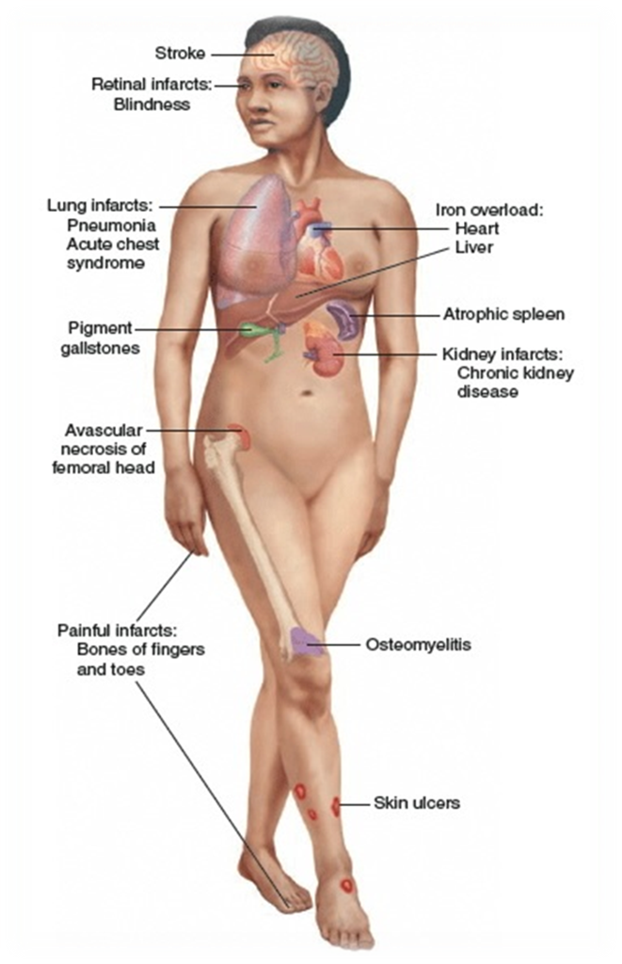
Sickle Cell Disease
Sickle cell disease (SCD) a group of inherited red blood cell disorders. People with SCD have abnormal hemoglobin, called hemoglobin S or sickle hemoglobin
stick to vessel walls, causing a blockage that slows or stops the flow of blood.
oxygen can’t reach nearby tissues, causing a pain crisis
The red cell sickling and poor oxygen delivery can cause severe pain and organ damage.
Over a lifetime, SCD can harm a person’s spleen, brain, eyes, lungs, liver, heart, kidneys, penis, joints, bones, or skin
By age 50, 50% of SCD patients had documented end organ damage
Notes:
The term sickle cell disease (SCD) describes a group of inherited red blood cell disorders. People with SCD have abnormal hemoglobin, called hemoglobin S or sickle hemoglobin, in their red blood cells.
Sickle-shaped cells are not flexible and can stick to vessel walls, causing a blockage that slows or stops the flow of blood. When this happens, oxygen can’t reach nearby tissues.
As we know, The red cell sickling and poor oxygen delivery can cause severe pain and organ damage.
Over a lifetime, SCD can harm every single organ in the body/
By age 50, 50% of SCD patients had documented end organ damage

Slide 3
Management: Then and Now
Many patients living SCD have been or are still under the care of a single care provider.
Treatment of sickle cell disease has become more than just treating pain.
Prevention and monitoring are key.
In the last decade, there has been a shift toward patient/family center care and collaboration, and patient engagement/involvement.
Notes:
As you just heard from Dr Turner, that have been many discoveries and advancement of sickle cell disease over the last century. And as such the management of Sickle cell disease has also advanced over the century
Many patients living with SCD have been or are unfortunately still under the care of a single care provider, weather that be a single hematologist or family physician, or some other primary care provider.
Certainly I believe that the treatment of sickle cell disease has become more than just treating pain- although that is still a very important aspect. There is more emphasize put on prevention and continuous monitoring.
In the last decade, there has been a greater shift toward patient/family center care and collaboration, with patient engagement/involvement

Slide 4
RBBD Clinic
Established in 2007
Mix of bleeding disorder patients and hemoglobinopathy patients
Comprehensive care model
Primary nursing model
Notes:
In the next few slides I will present our clinic- and what we are doing for SCD care, and how we feel these models have impact the care we provide to our Sickle cell population
Established in 2007
Mix of bleeding disorder patients and hemoglobinopathy patients
Comprehensive care model
Primary nursing model
I will talk more about these 2 specific models in the next few slides

Slide 5
Growth
Notes:
First I would just like to show the growth of Sickle cell patients in our clinic.
We have certainly grown in numbers over the years. We continue to get referral on a weekly basis.
On top of the referrals we receive from family doctors and other specialities - We also have young adults that transition from the pediatric center and anticipate another 35 kids who will be ready to transition in the next couple of years.

Slide 6
Comprehensive Care Model
holistic, multidisciplinary management approach
consist of 4 physicians, 3 nurses, unit clerk, physio, 2 psychologist, pharmacist and a social worker.
Treatment and prevention of acute and chronic complications
Goals
Reduce the number of hospital admissions
Decrease length of hospital stays, and
slow down organ damage caused by SCD
It’s all about improvement of patient's care, outcome and QoL
Notes:
So as I mentioned earlier our clinic has taken on a comprehensive care model approach.
This model is a holistic, multidisciplinary management approach
Although this model is used widely around the world , our clinic adapted the model used by the hemophilia centres in Canada, which has been around for a while and seems to work very well.
Our clinic currently consist of 4 physicians, 3 nurses, unit clerk, physio, 2 psychologist, pharmacist and a social worker.
Its primary focus is on individualized treatment and prevention of acute and chronic complications.
Goal is to reduce the number of hospital admissions and length of hospital stays, and slow down organ damage caused by SCD by continuously monitoring.
It’s all about improvement of patient's care, outcome and QoL

Slide 7
Comprehensive Care Model
Collaboration is key!!!
apheresis
ortho
ophthalmology
nephrology
public heath
cardiology
pharmacy
pain clinic
gynecology
pulmonology
MOST IMPORTANTLY THE PATIENT !
Notes:
IN comprehensive care model collaboration is key and thus we have established a relationship with many specialist outside of our clinic who have agreed to be involved in the care of our sickle cell patients.
They have become our “go to’s” when ever we need advice or a patient needs a consult.
Many of these specialist have also help to creat clinical guidelines to assist our clinic with the care and management of complications.
For example.
** We recently created some guidelines in collaboration with out OB / gyne group, for pregnancy in SCD.
** we have Collaborated with the pain clinic to create formal approaches to pain prescriptions
** we have collaborated with Ed to create individualized ED treatment plans
We are always looking for ways to improve the care of our patients,

Slide 8
Comprehensive Care Model
Benefits
Medical home
Team available for advice during business hours
Easy access to other specialties (psychology/SW) without needing a referral
A team that understands patient’s needs and can advocate for patients
Ability to address not only physical needs, but also mental health concerns, financial or employment concerns, drug coverage concerns.
Allows for quality improvement projects- both formal and informal projects
Development of clinic guidelines with a multidisciplinary input
Overall, enhances the relationship between the patient and care team
Notes:
The benefits of Using this type of model gives the patient a medical home, with a group of specialist that is available to give advise during business hours.
The medical system is not easy to navigate – even for those that work in the field.
So this is a easy access to get the help that the patient requires in a timely matter, and easier access to other specialists
This type of model also allows the team to address not only physical needs, but also mental health concerns, financial or employment concerns, drug coverage concerns, and so on all in one area
It also helps with quality improvement projects. Both formal and informal. And as I mentioned in the previous slide it has benefit the team in creating clinical guidelines – with input from a variety of specialties
Providing this type of multidisciplinary management approach overall enhances the relationship between the patient and the care team.

Slide 9
Primary Nursing Model
A single nurse is identified as the point of contact and primary caregiver for a patient
Responsible for the planning, implementing, evaluating and management of care.
Clinic population split between 3 nurses.
Cross cover
Essential with establishing a trusting relationship.
Notes:
In combination with the comprehensive care model that was just discussed, we have also adapted components of primary nursing model as well
Primary nursing is defined as a single nurse that is identified as the point of contact and primary caregiver for a patient.
That single nurse is Responsible for the planning, implementing, evaluating and management of care.
Our Clinic has 3 nurses and each has taken on a specific population ( so we have a SCd nurse, a thal nurse , and a bleeding disorders nurse)
All 3 nurses do Cross cover each other – so someone is always available to attend to any acute or emergency issues.
Essential with establishing a trusting relationship with the patient. I feel patients are feeling more comfortable calling in with questions, concerns,

Slide 10
Nursing Role in Sickle Cell Care
Notes:
21th century Nursing is more than just following doctors' orders- and providing care to patients.
As I noted in the previous slide, with using the primary nursing model the nurse is responsible for the planning, implementing, evaluating and management of care. And thus take on many roles within this position.
In the next few slides I will go over the role in more detail

Slide 11
Care Provider
Nurses are the first point of contact for most patients in our clinic
Triage phone calls and provide advise
Nurse available via phone or email
Follows the patient while admitted to hospital to ensure that patients needs are met.
Arrange for bloodwork, and DI test
Referral to other sub specialities
Coordinate care for procedure ( RBCX, Sx)
Consult with other team members
Notes:
Nurses as Care providers :
Nurses are the first point of contact for most patients in our clinic
We Triage phone calls and provide advise
We are available via phone or email
When a patient is admitted to our center, we make a point to go see the patient to ensure that all their needs are met.
We Arrange for bloodwork, and DI test
We Referral the patient to other sub specialities as necessary
We Coordinate care for procedure ( RBCX, Sx)
Consult with other team members whenever necessary

Slide 12
Educators
Educating inpatient staff on SCD and patient needs
Educating the Emergency Department.
Provide education during their mandatory educational sessions
Meet with the educators and manager to improve the care of SCD in ED
Individualized pain protocol
Educating patients
One on one during clinic visits
On line educational sessions
Every interaction with the patient and
inpatient staff is an opportunity for teaching.
Notes:
Our role as an educator consist of ……
Educating inpatient staff on SCD and patient needs
Educating the Emergency Department.
We Provide education during their mandatory educational sessions
We Meet with the educators and manager to brainstorm about way to help improve the care these patient receive in ED
We just created Individualized pain protocol in the patients electronic medical chart……
Educating patients
One on one during clinic visits
On line educational sessions
Every interaction with the patient and
inpatient staff is an opportunity for teaching

Slide 13
Collaborating and Advocating
Advisory committee
Consist of physician, nurse, social worker, SCFA Calgary chapter representatives and patients.
Regular meetings
Consult regarding issues, review of new policies or educational material
Established a working group with the SCFA-Calgary Chapter
Regular meetings
Send out information, flyer, emails, etc
Collaborating with other specialist to create guideline to improve the quality of care
Notes:
As I noted before collaboration is key
I am currently on several committees and working groups. We have recently established an advisory committee. This consist of Dr Rydz, myself, our clinical social worker, members of the SCFA Calgary chapter and several patients
We have Regular meetings
And Consult on issues, review of new policies or educational material
Established a working group with the SCFA-Calgary Chapter
Regular meetings
We have been a key point of contacting our patient and sending out information, flyer, emails, etc on events, newsletters, from the chapter.
I have been involved in the working groups with other specialist , collaborating, and create guideline to improve the quality of care
Always looking for input from patients and ways to improve the quality of care for our patients

Slide 14
Research
Co-investigator to Dr Rydz
SCD and Pain Tool
questionnaire
patients describe their pain
assist clinicians in understanding patients pain and to help develop an effective individualized treatment plan
SCD and HU
Received funding from Sickle Cell Disease Association of Canada
Looking at the barriers for compliance
Developing a variety of education tools to assist with HU teaching.
Developing a guideline/protocol for nurses or pharmacist to help patient get to MTD quickly.
Notes:
Certainly over the years there hasn’t been much in terms of research from nurses, but like may other things, there is a shift and so over the last decade or so, nurse have been encouraged to participate in more research.
I am very honored to be working in the area of research as a co investigator to Dr Natalia Rydz.
Currently we have 2 Sickle cell disease projects on the go
SCD and Pain Tool
Developing a pain questionnaire that will help not only the patients describe their pain, but also to assist clinicians in understanding patients pain and to help develop an effective individualized treatment plan
SCD and HU
Received funding from Sickle Cell Disease Association of Canada for this project – so I would like to say a big thank you to them for their support.
Looking at the barriers for compliance to HU
Developing a variety of education tools to assist with HU teaching.
Developing a guideline/protocol for nurses or pharmacist to help patient get to MTD quickly.

Slide 15
The Future for Sickle Cell Disease
Notes:
I am excited to see what the futures holds for those with sickle cell disease.
As you know we are making advances with treatment in BMT, and gene therapy, as well as new medication that have just been approved in the USA
We certainly need to continue with Ongoing research and clinical trial for new treatment.
We need to continue to advocate, collaborate and work together to create guidelines that will improve the care
I am truly blessed to be part of this amazing team, and to be a part of all the great work that be done at our clinic.
We will certainly continue to work hard to improve the care for SCD.

Slide 16
Questions

Slide 17
References
2010. A Century in Progress: Milestones in Sickle Cell Disease Research and Care. NHLBI Health Information Center, https://www.nhlbi.nih.gov/files/docs/public/blood/Tagged2NHLBISickleCellTimeline.pdf
2015. Defining the role of the RN. Nurses Association of New Brunswick. http://www.nanb.nb.ca/vforum/entry/defining-the-role-of-the-rn
2012. Role of the Nurse in the Multidisciplinary Team Approach to Care of Liver Transplant Patients. JOYCE A.OVERMANR.N.DEBRA L.COXR.N.LINDA L.BUCHLR.N.JULIE K.CAMPIONR.N.PAULA C.RAIHLER.N.THOMAS R.SLOANR.N.

