Slide 1
Advances in understanding SCD
Sickled red cells seen in blood of pte with painful crisis
Deoxygenation causes sickling
SCD is inherited, not acquired
Hemoglobin S described by Pauling and Ingram
Hemoglobin F protects against sickling

Slide 2
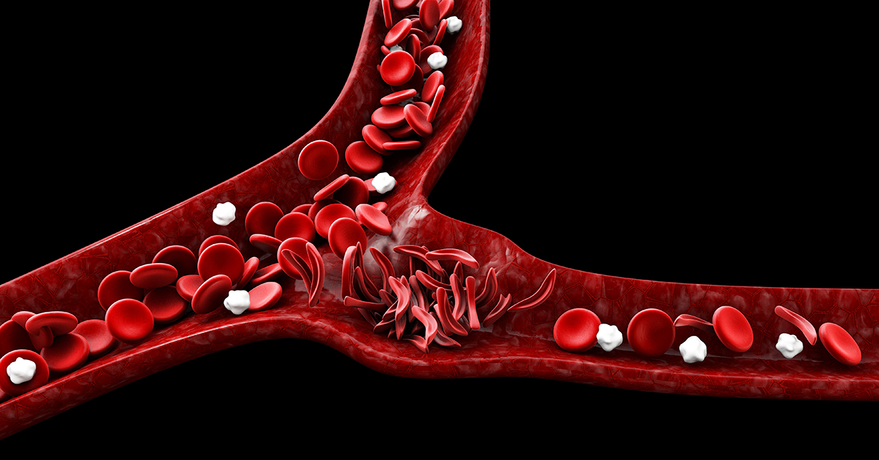

Slide 4
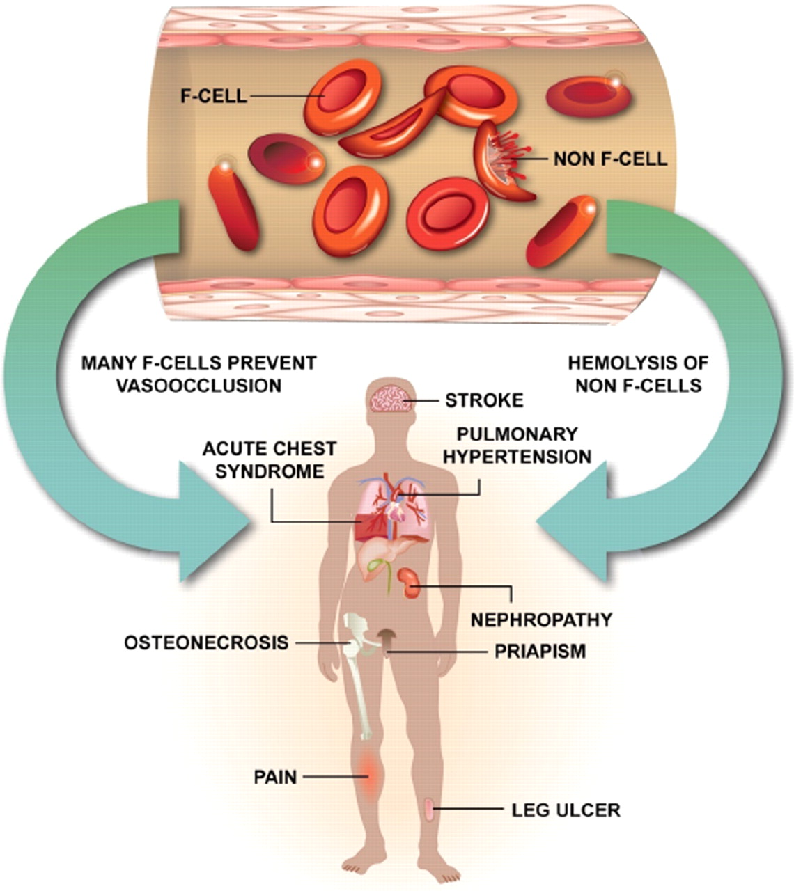

Slide 5
Advances in treatment of SCD
1950 Red cell transfusions for crises
1980 Hydroxyurea reduces number of crises
1990 Allogeneic bone marrow transplants tried
2013 Gene editing with CRISPR-Cas 9
2019 CRISPR edited autologous stem cell transplants

Slide 6
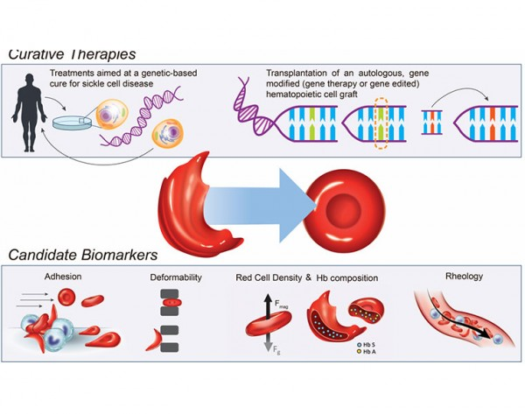

Slide 7
CRISPR gene-editing treatment
Hematopoietic stem cells are collected by apheresis from blood of SCD (or beta thal) patient.
A specific CRISPR reagent is used to “turn on” Hemoglobin F production. The HSC are then frozen and stored.
To make room for the treated HSC, chemotherapy is administered. The stored treated HSC are then infused.
It takes ~ 3 weeks for the treated HSC to produce red cells, white cells and platelets.

